Slide 1
CIFAR-10
Object Recognition using Convolutional Neural Networks

Slide 2
Content Outline
Dataset
Goal
Architecture of the Convolutional Neural Network
Models implemented
Results

Slide 3
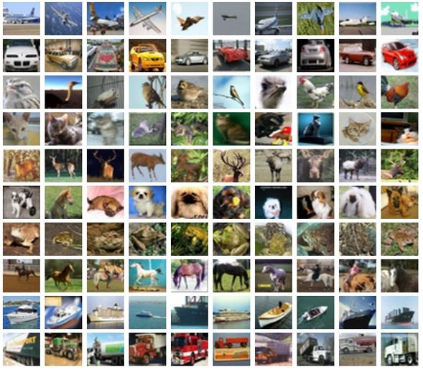
CIFAR-10
Labels
Airplane
Automobile
Bird
Cat
Deer
Dog
Frog
Horse
Ship
Truck
CIFAR-10
10 labels
50,000 training images
10,000 test images
image size: 32x32x3 (height, width, depth)
* depth = color channels

Slide 4
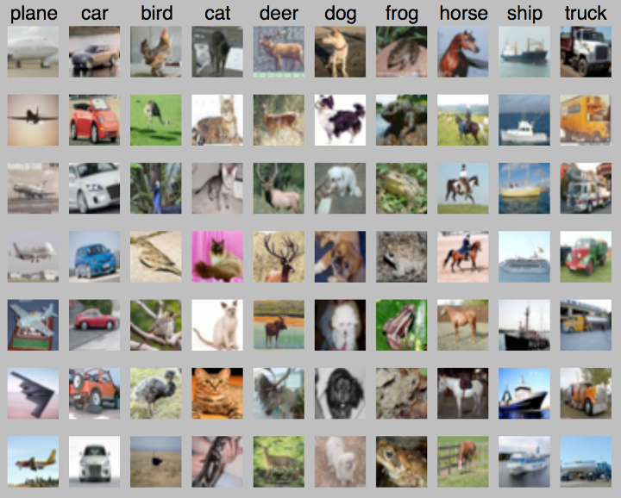
Goal

Slide 5
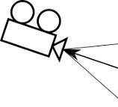

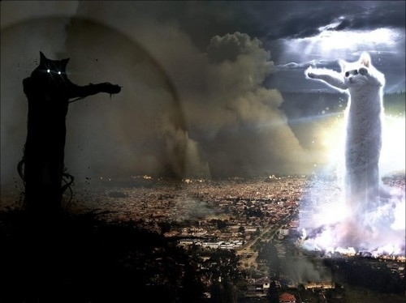

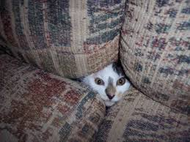
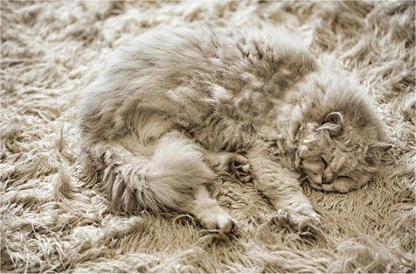
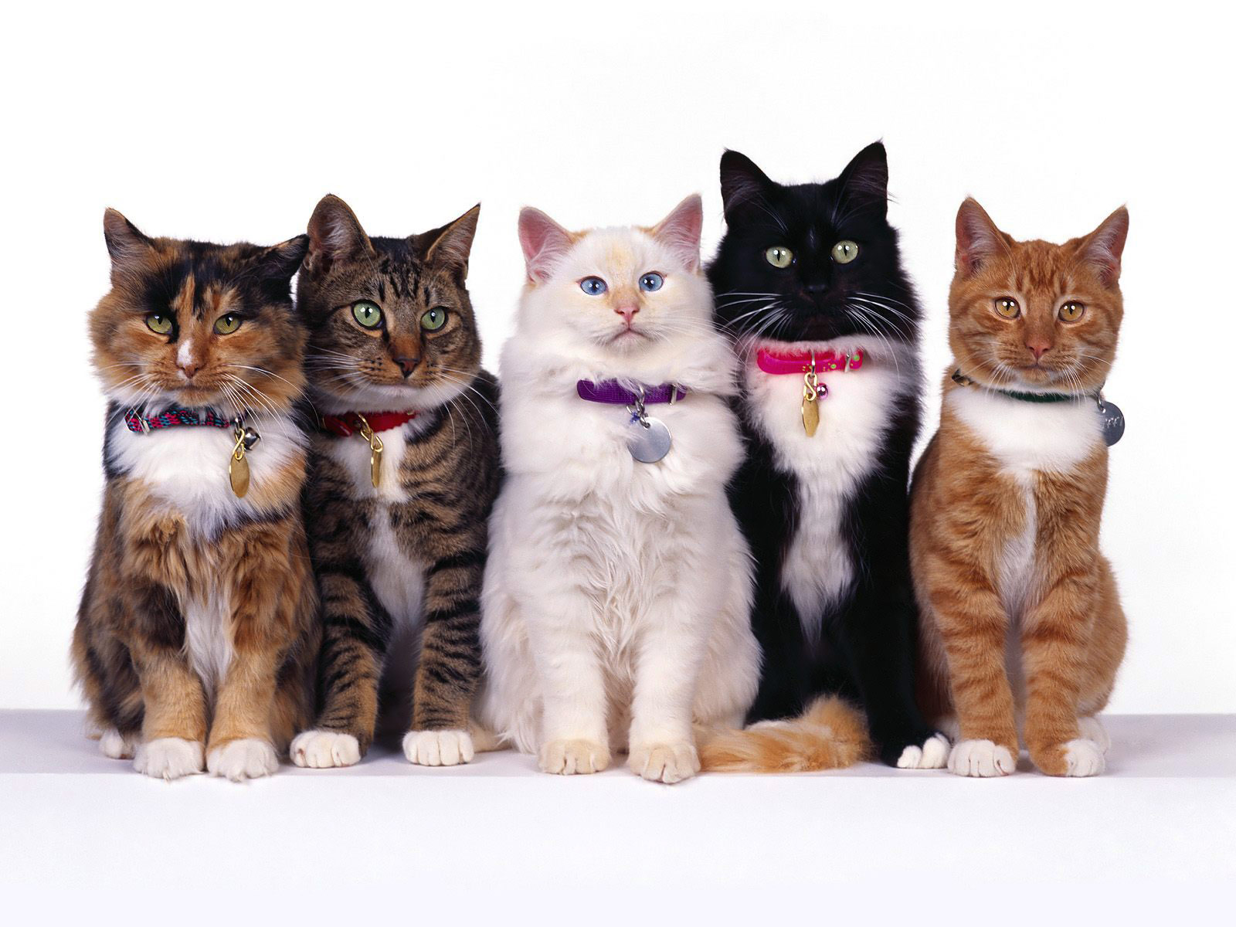
Challenges in Visual Recognition
Camera pose
Illumination
Deformation
Hidden Parts
Background clutter
Intraclass variation

Slide 6
Pre-processing Techniques (Training)
Normalization
Normalization of the data dimensions, so that they are of approximately the same scale
Data Augmentation
Add “synthetic” data (variations of the original input), not new “authentic” information
Way of reducing over-fitting and expanding the dataset
Often simple and accessible solution
Useful when semantically correct (!)

Slide 7
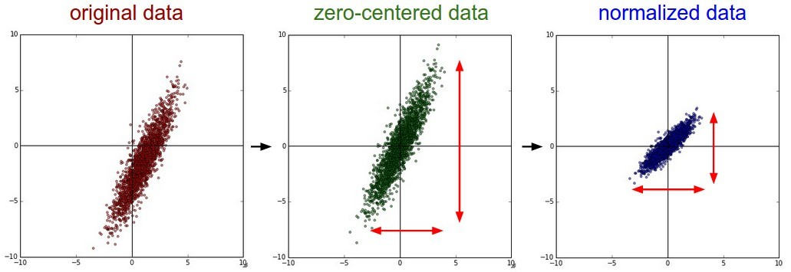
Normalization
Two common ways:
Subtract mean and divide each dimension by its standard deviation
Normalization by Scaling Between 0 and 1
Limit the image pixels between [0, 1] in case of overflow (max, min)

Slide 8
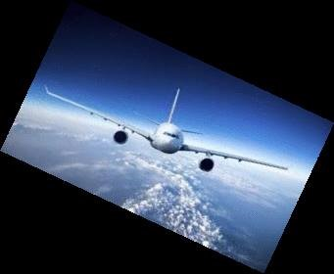
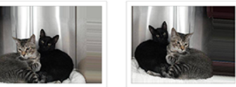
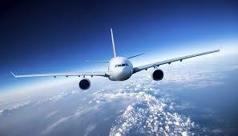
Data augmentation
Randomly crop the input images
Randomly flip them horizontally/vertically
Hue, contrast, brightness and saturation are adjusted with random values
Vertical flip
25^{ο} Rotation

Slide 9
Pre-processing Techniques (Testing)
The input images are cropped around the center and nothing else is adjusted, in order to have the same size as images that are randomly cropped during training

Slide 10
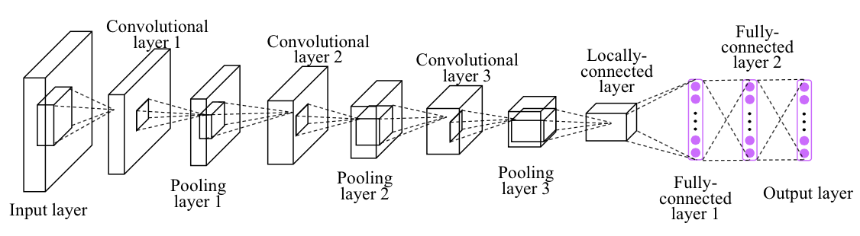
Convolutional Neural Networks Architecture
Similar to how blur filters work on images by applying the Gaussian blurring technique
STEPS:
Moving filter (n x n square box) passes through every pixel
New pixel color is produced by averaging all the pixels in the box
Each pixel in the filter is weighted based on how far away it is from the center
Pixels closer to the center affect the output more
More natural blurring

Slide 11
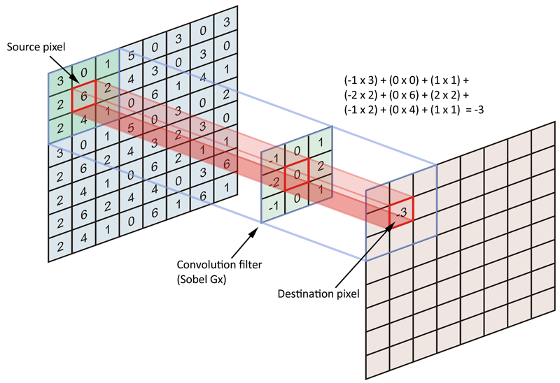
CNNs Architecture (2)
Optimizer: Adam (SGD, Adagrad etc.)
in order to train parameters (weights, bias) and improve
performance
Each Convolutional Layer deconstructs the image into different repetitive patterns in order to provide different information about the image
The more Convolutional Layers are added, the more the model’s parameters increase
→ danger of overfitting
→ longer training times

Slide 12
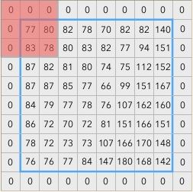
CNNs Architecture (3) – Padding
A preparation method of filtering for edge of image properly without reducing image size
Zero- padding technique:
Pads the input volume with zeros around the border (broadly used for CNN)
Deployment: Zero-padding

Slide 13

CNNs Architecture(4) - Max Pooling
Objective: Down-sampling
→ reduce the model’s complexity
→ reduce training time
32 x 32 x 32
16 x 16 x 32
Max-Pooling technique:
divides the image into non-overlapping sections
picks the largest value of each section
Stride of (2,2):
means that the filter moves 2 steps in the x and y directions
reduces dimensionality
avoiding overlap
32
16
16
32
Deployment: Max-Pooling Layers of 2x2 pool sized regions (strides)

Slide 14
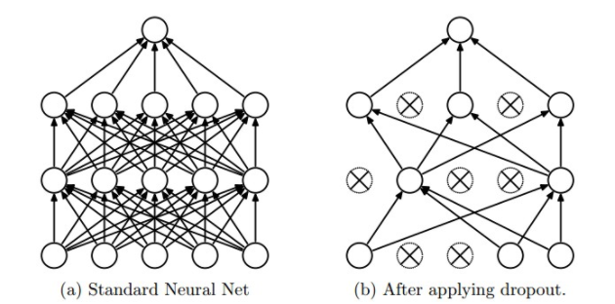
CNNs Architecture (5) – Dropout
A regularization technique to diminish the possibility of overfitting.
Dropout technique:
Some neurons are thrown away
Keep the more useful depending on their contribution
Prevents a layer of seeing twice the exact same pattern
Eliminates random data correlations
Deployment: Dropout 25% and 50%

Slide 15
CNNs Architecture (6) – Fully Connected Layers
Come at the end of CNN model in order to implement the classification process of images
In order to connect the output of the final max-pooling layer to the classification process, we have to flatten its output into a single (n x 1) tensor.

Slide 16
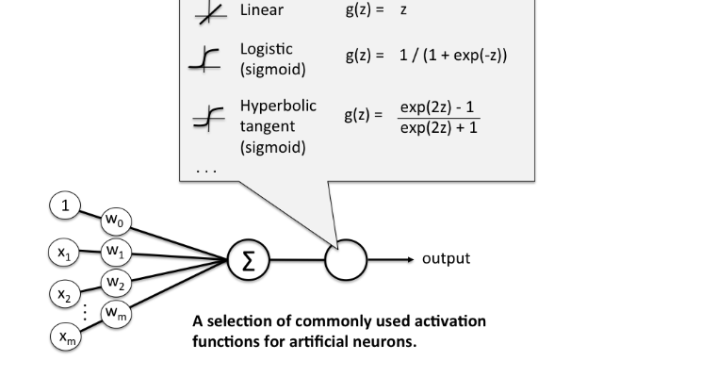
CNNs Architecture (7) – Activation Functions
They introduce linear or non-linear properties to the Convolutional Neural Network .
Main Purpose
Convert an input signal of a node in a CNN model to an output signal, which itself becomes input of the next layer in the stack.
Examples of non-linear activation functions
Sigmoid
Hyperbolic tangent
ReLu
etc
* Lack of activation function transforms the NN into a simple Linear Regression model.

Slide 17
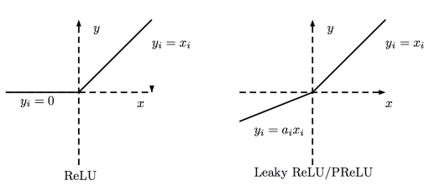
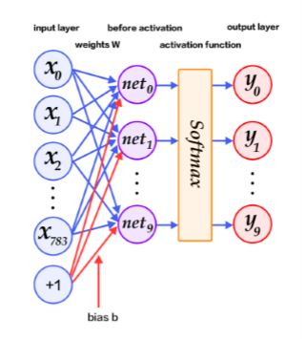
CNNs Architecture (8) - Rectified Linear units (ReLu) and Softmax
R(x) = max(0,x) if x < 0 => R(x) = 0 and if x >= 0 => R(x) = x
Avoids and corrects the vanishing gradient problem
It is 6 times better in convergence than Tanh function
Leaky ReLu fixes the problem of dead neurons during training if learning rate is set too high
It can only be used within Hidden layers (Convolutional & Fully-Connected)
Output Layer
Compute the probabilities of the classes

Slide 18
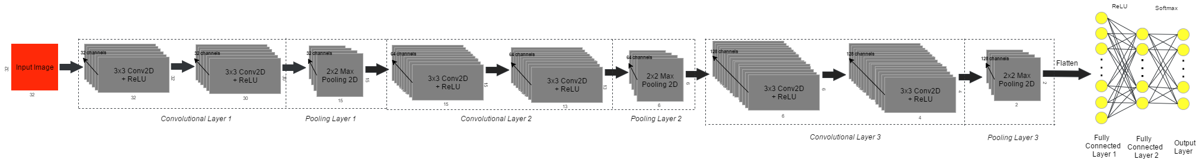
No1 Multilayer Model
Data Preprocessing |  | Image normalization
Data Augmentation | x
Model Structure
Loss | Categorical cross entropy
Optimizer | Adam
Metrics | Accuracy
Total / Trainable parameters | 683.562
Batch size | 32
Epochs | 2

Slide 19
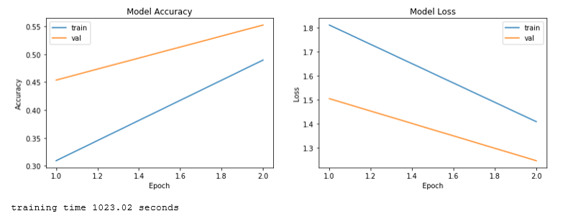
No1 Multilayer Model
Accuracy | 55,22%

Slide 20
No2 Multilayer Model
Data Preprocessing |  | Image normalization
Data Augmentation | x
Model Structure
Loss | Categorical cross entropy
Optimizer | Adam
Metrics | Accuracy
Total / Trainable parameters | 683.562
Batch size | 32
Epochs | 100

Slide 21
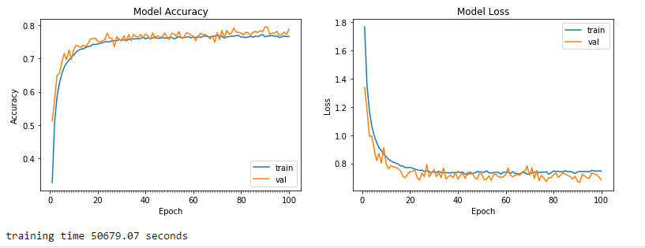
No2 Multilayer Model
Accuracy | 78,82%

Slide 22
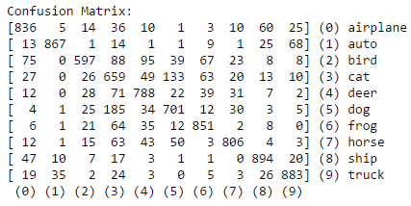
No2 Multilayer Model
Mis-classifies the living ones
Dogs as being Cats (185)
Birds as being Deers (95)
Birds as being Cats (88)
Birds as being Airplanes (75)

Slide 23
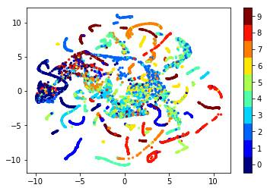
No2 Multilayer Model
t-SNE visualization
Truck
Ship
Horse
Frog
Dog
Deer
Cat
Bird
Auto
Airplane

Slide 24
No3 Multilayer Model
We implemented the code, however due to lack of resources we didn’t manage to train the model and gain results.
Data Preprocessing |  | Image normalization
Data Augmentation |  | Set input mean
 | Set input mean to 0
 | Divide inputs by std
 | Randomly flip
 | Randomly shift horizontally
 | Randomly shift vertically
 | Randomly rotate by 40^{ο}
 | 20% zoom
 | ZCA whitening
 | Fill the points outside the boundaries of the input according to the nearest one
Model Structure

Slide 25
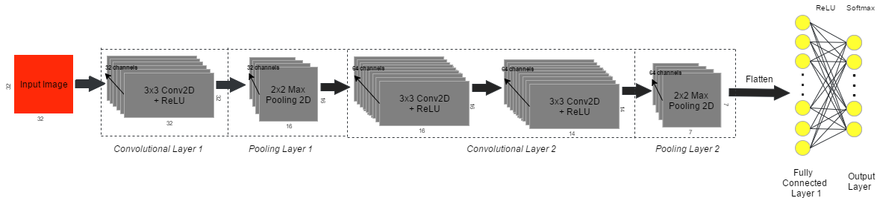
No4 Multilayer Model
Data Preprocessing |  | Image normalization
Data Augmentation |  | Set input mean to 0 Divide inputs by std Randomly flip Randomly rotate by 25^{ο}
Model Structure
Loss | Categorical cross entropy
Optimizer | Adam
Metrics | Accuracy
Total / Trainable parameters | 1.667.594
Batch size | 32
Epochs | 50
Microsoft Azure
approximately 50 hours training
77 % accuracy

Slide 26
